Slide 1
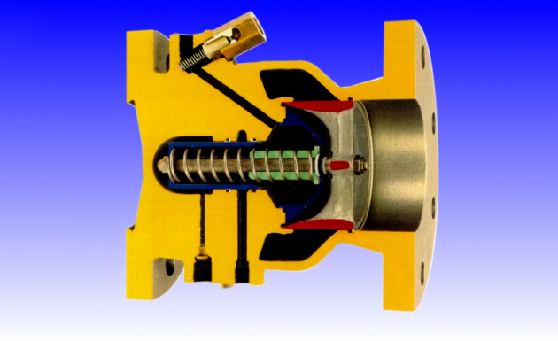
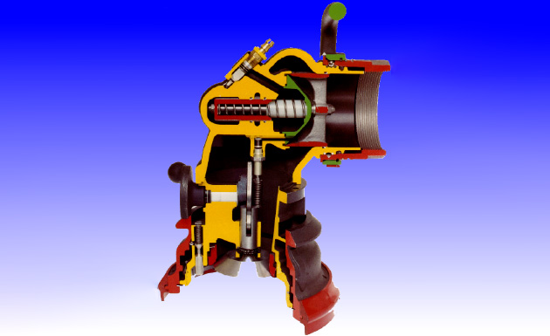
Mounted in piping
Mounted on Inlet hose
2 Types of “ILCV”
Pressure Controller

